Slide 1
Fulfilling the American Dream: Liberal Education and the Future of Work
Key findings from surveys of business executives and hiring managers conducted May-June 2018
Conducted on behalf of
with support from
Notes:
12360
Note: vertical expressions for subgroups except where noted

Slide 2
Methodology
Parallel online surveys among:
501 business executives
Executives at private sector and nonprofit organizations, including owners, CEOs, presidents, C-suite level executives, vice presidents, and directors
500 hiring managers
Non-executives (directors, managers, supervisors, office administrators) whose current job responsibilities include recruiting, interviewing, and/or hiring new employees
All respondents were screened to be at companies that have at least 25 employees and report that 25% or more of their new hires hold either an associate’s degree from a two-year college or a bachelor’s degree from a four-year college.

Slide 3
Employers on the Value of College and the Role of Colleges and Universities

Slide 4
More than six in 10 executives and hiring managers express confidence in colleges and universities.
Confidence in Colleges and Universities
This is higher than confidence in colleges and universities among adults nationwide:
63%
63%
54%
45%
37%
37%
(January 2018, Gallup)
Business executives
Hiring managers
Notes:
Q.3

Slide 5
Confidence in Colleges/Universities, by Key Subgroups
Have a great deal/quite a lot of confidence in colleges/universities
 |  | Business executives | Hiring managers
BY COMPANY SIZE | 25 to 99 employees | 64% | 60%
 | 100 to 499 employees | 62% | 61%
 | 500+ employees | 64% | 68%
BY OPERATING REGION | Local | 65% | 63%
 | Regional | 68% | 58%
 | National | 58% | 65%
 | Multinational | 63% | 68%
BY REGION | Northeast | 65% | 60%
 | South | 67% | 63%
 | Midwest | 69% | 71%
 | West | 53% | 59%
Circled numbers are significantly different from all executives or all hiring managers.
Notes:
Q.3

Slide 6
Executives and hiring managers alike agree on the value of college.
Importance of Completing a College Education
Evaluation of Whether a College Degree Is Worth the Time and Money Involved
88%
85%
82%
75%
25%
18%
Business executives
Hiring managers
Business executives
Hiring managers
Notes:
Q.4, 5

Slide 7
Employers describe what they think the value of college is.
In Their Own Words
“The overall college experience is an excellent way to offer diversity, development of all forms of communication, self-discipline, independence, and personal responsibility. These qualities are critical for the workplace.” –Hiring manager
“Potential for advancement is far greater for the college graduates.” –Hiring manager
“A good college can instill a combination of hard job-specific skills and soft real-world skills that can allow a job candidate to contribute to our organization quickly. The degree demonstrates the individual’s ability to commit to a path and complete an objective.” –Business executive
“No matter what an individual’s degree is in, the college experience produces a well-rounded individual who is prepared to interact with high-level employees.” –Business executive

Slide 8
Majorities of executives and hiring managers say it is difficult to fill open positions today.
How easy or difficult is it to fill open positions at your company or organization today?
Very easy
Somewhat easy
Somewhat difficult
Very difficult
Business executives
Hiring managers
56%
DIFFICULT
44%
EASY
54%
DIFFICULT
46%
EASY
Notes:
Q.7

Slide 9
Difficulty Hiring Today, by Key Subgroups
It is somewhat/very difficult to fill positions at my company today
 |  | Business executives | Hiring managers
BY COMPANY SIZE | 25 to 99 employees | 54% | 58%
 | 100 to 499 employees | 60% | 59%
 | 500+ employees | 53% | 47%
BY OPERATING REGION | Local | 52% | 52%
 | Regional | 51% | 53%
 | National | 60% | 55%
 | Multinational | 60% | 58%
BY REGION | Northeast | 58% | 57%
 | South | 51% | 47%
 | Midwest | 56% | 56%
 | West | 59% | 59%
Notes:
Q.7

Slide 10
Both employer audiences express broad satisfaction with recent college graduate hires’ ability to apply skills and knowledge they learned in college.
Satisfaction with Recent Graduates’ Ability to Apply Skills and Knowledge They Learned in College to Complex Problems in the Workplace
71%
74%
Business executives
Hiring managers
Notes:
Q.8

Slide 11
Employers view their recent hires out of college as mostly prepared to succeed in entry-level positions but not necessarily to advance beyond that.
Proportions of Recent College Grad Applicants Who Have Full Set of Skills/Knowledge
Succeed in entry-level positions at the company
= 57% all/most have
= 60% all/most have
Advance/be promoted within the company
= 34% all/most have
= 25% all/most have
Notes:
Q.9

Slide 12
Majorities believe that colleges need to make improvements to ensure that graduates gain the skills and knowledge needed for success, especially for advancement.
Assessment of Job Colleges/Universities Are Doing in Ensuring College Graduates Have Full Set of Skills/Knowledge Needed for Entry-Level Positions/Advancement
Entry-level positions at your company
Advancement/promotion at your company
65%
65%
56%
53%
Business executives
Hiring managers
Business executives
Hiring managers
Notes:
Q.1, 2

Slide 13
Employers’ Priorities for College Learning and Sense of Recent Graduates’ Preparedness

Slide 14
The learning priorities that executives and hiring managers value most highly cut across majors.
Very Important* Skills for Recent College Graduates We Are Hiring
85% in 2014
81% in 2014
81% in 2014
83% in 2014
82% in 2014
80% in 2014
* 8-10 ratings on a 0-to-10 scale; 15 outcomes tested
Notes:
Q.10

Slide 15
Executives and hiring managers rank several other learning outcomes as only slightly less important.
Very Important* Skills for Recent College Graduates We Are Hiring
68% in 2014
70% in 2014
56% in 2014
65% in 2014
60% in 2014
56% in 2014
23% in 2014
* 8-10 ratings on a 0-to-10 scale; 15 outcomes tested
Notes:
Q.10

Slide 16
Notable gaps emerge between the importance of key learning outcomes and executives’ sense that recent graduates are prepared in these areas, even with some improvements.
Among business execs:
Recent college grads well prepared*
Very important quality*
Prepared Gap
-44
-43
-43
-41
-40
-39
-35
-34
-33
-32
-29
-25
-18
-8
-1
2014 Gap
-55
-57
-55
N/A
-57
N/A
-46
-51
-46
-39
-38
-40
-28
-23
-7
Critical thinking/analytical reasoning
Apply knowledge/skills to real world
Communicate effectively in writing
Self-motivated
Communicate effectively orally
Able to work independently
Able to work effectively in teams
Ethical judgment/decision-making
Able to analyze/solve complex problems
Find, organize, evaluate info: multiple sources
Solve problems w/people of diff. backgrounds
Able to innovate/be creative
Able to work with numbers/stats
Stay current on changing tech
Proficiency in foreign language
* 8-10 ratings on a 0-to-10 scale
Notes:
Q.10, 11 (TREND: 11369b Q6, Q7a)

Slide 17
Hiring managers also identify gaps in recent graduates’ preparedness on key learning outcomes.
Among hiring managers:
Recent college grads well prepared*
Very important quality*
Prepared Gap
-48
-46
-43
-43
-43
-40
-37
-37
-33
-33
-30
-25
-16
-12
-2
Apply knowledge/skills to real world
Self-motivated
Communicate effectively orally
Critical thinking/analytical reasoning
Able to work independently
Ethical judgment/decision-making
Able to work effectively in teams
Able to analyze/solve complex problems
Communicate effectively in writing
Find, organize, evaluate info: multiple sources
Solve problems w/people of diff. backgrounds
Able to innovate/be creative
Stay current on changing tech
Able to work with numbers/stats
Proficiency in foreign language
* 8-10 ratings on a 0-to-10 scale
Notes:
Q.10, 11

Slide 18
Executives and hiring managers identify similar gaps in recent graduates’ preparedness on key learning outcomes.
Preparedness Gap: % recent grads prepared minus % very important skill to have
 | Business executives | Hiring managers
Critical thinking/analytical reasoning | -44 | -43
Apply knowledge/skills to real world | -43 | -48
Communicate effectively in writing | -43 | -33
Self-motivated | -41 | -46
Communicate effectively orally | -40 | -43
Able to work independently | -39 | -43
Able to work effectively in teams | -35 | -37
Ethical judgment/decision-making | -34 | -40
Able to analyze/solve complex problems | -33 | -37
Find, organize, evaluate info: multiple sources | -32 | -33
Solve problems w/people of diff. backgrounds/cultures | -29 | -30
Able to innovate/be creative | -25 | -25
Able to work with numbers/stats | -18 | -12
Stay current on changing tech | -8 | -16
Proficiency in foreign language | -1 | -2
Notes:
Q.10, 11

Slide 19
Applied and project-based learning experiences, particularly internships or apprentice experiences, give recent college graduates an edge with both employer audiences.
Would be MUCH More Likely to Hire Recent Grad with this Experience
Much/ somewhat more likely
93% 94%
72% 83%
82% 72%
81% 81%
80% 76%
71% 78%
54% 47%
Notes:
Q.14

Slide 20
Executives and hiring managers think ePortfolios are more useful than college transcripts alone.
Usefulness of College Transcripts in Evaluating Recent Graduates’ Potential to Succeed
Usefulness of College Work ePortfolio in Evaluating Recent Grads’ Potential to Succeed
(in addition to resume and transcript)
78%
81%
51%
48%
Business executives
Hiring managers
Business executives
Hiring managers
Notes:
Q.18, 19a

Slide 21
Employers Providing Professional Development

Slide 22
Most employers provide professional development opportunities.
Does your company provide professional development? If so, what is its main focus?
Provide professional development:
Advanced skills for more responsibility/advancement
Do not provide professional development
Equally basic/advanced skills
Basic skills needed for job
79%
79%
By company size (# of employees)
Busn execs
70%
78%
87%
Hiring mgrs
74%
74%
90%
25 to 99
100 to 499
500+
Business executives
Hiring managers
Notes:
Q.15ab

Slide 23
The most common programs are in-house training, training on use of programs/systems, management training, and mentoring.
Types of Professional Development Company/Organization Provides
Provided more
Provided less
Notes:
Q.15c

Slide 24
Executives and hiring managers indicate that their companies partner with colleges/universities in a variety of ways.
Partnerships with Colleges/Universities
Ways Company Partners with Colleges/Universities
 | Business execs | Hiring mgrs
Offer service learning, internships, apprenticeships to students | 30% | 32%
Leaders/staff serve on boards to advise on curriculum development | 20% | 17%
Employees are adjunct faculty to teach courses our company needs | 18% | 15%
Company sponsors a scholarship at a college or university | 17% | 17%
Collaborate to develop industry-specific degrees or credentials | 16% | 13%
Host college/university course(s) at company’s location | 12% | 11%
Other ways we partner | 4% | 3%
Business executives
Hiring managers
Employers at larger companies/organizations are more likely to say they partner with colleges/universities in these ways.
Notes:
Q.16

Slide 25
Appendix

Slide 26
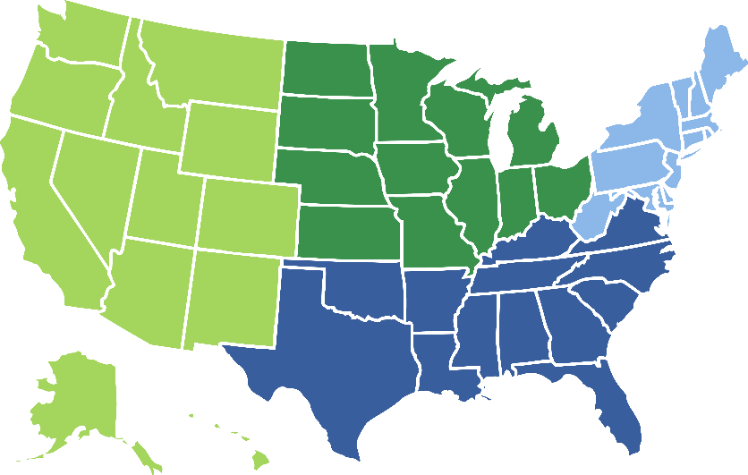
Company/Organization Profile of Executives
COMPANY TYPE/SIZE
Local
Regional
National
Multinational
Private company
Non- profit
Midwest
24%
Northeast
25%
West
23%
500+ employees
25 to 99 employees
100 to 499 employees
South
28%
Notes:
Q.S3, S1, F1, banner 1

Slide 27
Company/Organization Profile of Hiring Managers
COMPANY TYPE/SIZE
Local
Regional
National
Multinational
Non- profit
Private company
Midwest
23%
Northeast
25%
West
24%
500+ employees
25 to 99 employees
West
23%
Midwest
24%
100 to 499 employees
South
28%
Notes:
Q.S3, S1, F1, banner 3

